Slide 1
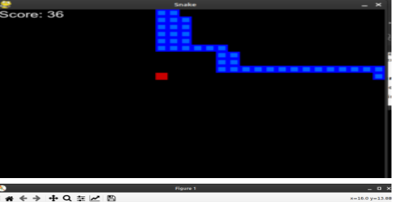
Snake Game Using Deep Q Learning
Devansh - CS21B2023
Swaraj - CS21B2024
Anmol - CS21B2027

Slide 2
About Snake Game
The Snake game is a classic arcade game where the player controls a snake to eat food and grow longer without colliding with the walls or itself. The objective is to achieve the highest score by eating as much food as possible. The game ends if the snake hits the walls or its own body.

Slide 3
Why Deep Q Learning?
1. Complex State Handling: DQL effectively manages the game's high-dimensional state space using deep neural networks.
2. Raw Pixel Input: It can learn directly from the game's visual representation without manual feature engineering.
3. State Generalization: DQL generalizes well across different game states, allowing the snake to make smart decisions in new situations.
4. Experience Replay: This technique stabilizes learning by reusing past game experiences, breaking the correlation between consecutive states.
5. Scalability: DQL can adapt to increasing game complexity, making it a robust and scalable solution for training in the Snake game.

Slide 4
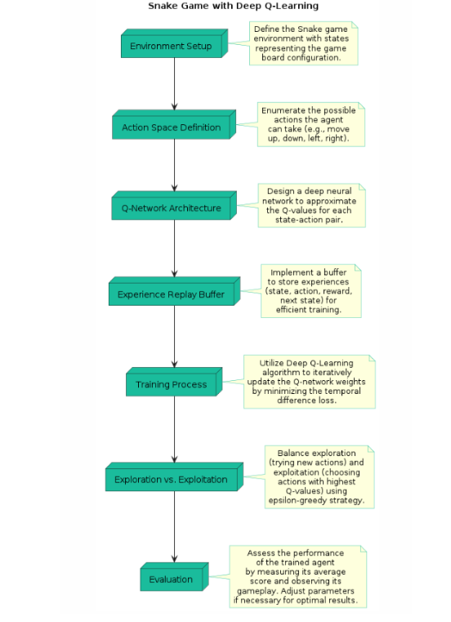
Working Diagram:

Slide 5
Working Process
Implementation of DQN architecture
The Linear_QNet class initializes a neural network with input, hidden, and output sizes, using PyTorch linear layers and ReLU activations. The QTrainer class trains the DQN model by computing target Q-values, minimizing squared error loss, and updating model parameters with the Adam optimizer through backpropagation.

Slide 6
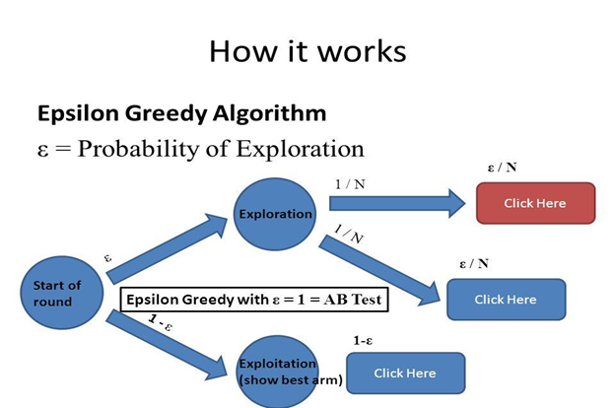
Working Principle
Training Process
Training starts after accumulating sufficient episodes in replay memory. Randomly sampled batches from replay memory are processed into numpy arrays for TensorFlow operations. The QTrainer class trains the neural network with these batches via backpropagation. Epsilon-greedy exploration gradually decays, balancing exploration and exploitation over time.

Slide 7
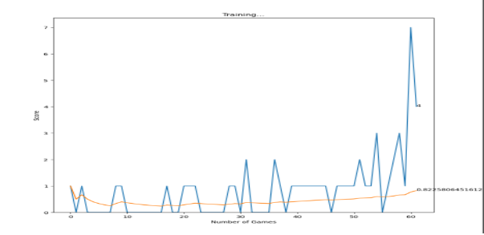
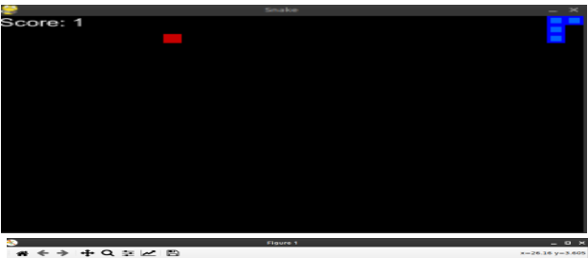
Agent’s Process
the Snake game interface with a black background. It features the food as a red square and the snake represented by a blue square. A score of 1 is shown in the top-left corner. Image 2 exhibits a training plot for a Deep Q-Learning agent playing Snake. Initially fluctuating, the agent's scores stabilize and improve over time, peaking around the 50th game. These visuals encapsulate the agent's progression in mastering the Snake game.

Slide 8
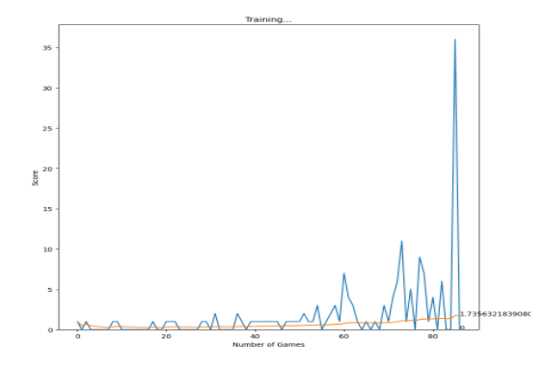
Advanced stage of the Snake game, with the snake (blue squares) having consumed 36 food pieces, elongating its body. Image 2 illustrates the training progress of the Deep Q-Learning agent, showing an upward trend in scores over games played. The agent's growing

Slide 9
Performance Metrics
The execution loop runs through a set number of games, initializing each with `reset()`, and simulating gameplay with `play_step()`. Depending on the training count, output and graphics may be suppressed. If recording is enabled, game data (state, actions, rewards) is saved using pickle. After all games, performance is evaluated by calculating the average score, printing individual scores, win rate percentage, and summarizing game outcomes as wins or losses.

Slide 10
Challenges Faced
Training an agent to play the Snake game involves several challenges. The dynamic environment requires accurate modeling of snake movement, food placement, and collision detection. Effective exploration strategies, such as epsilon-greedy, are needed to balance exploration and exploitation for food capture. The agent must manage the discrete action space (up, down, left, right) efficiently. Replay memory management is crucial for storing and sampling experiences during training, with memory constraints posing challenges. Hyperparameter tuning for learning rate, discount factor, batch size, and network architecture is time-consuming but essential. Computational complexity requires substantial power, mitigated by mini-batch training, GPU acceleration, and model compression.

